Slide 1
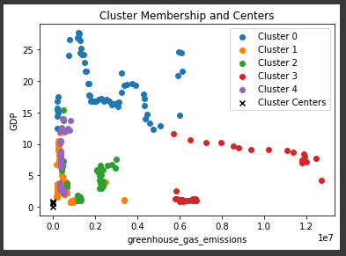
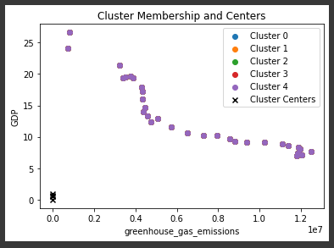
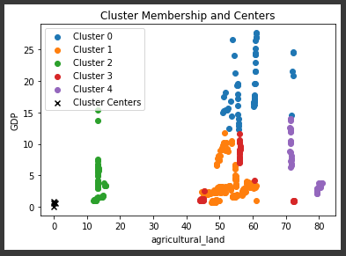
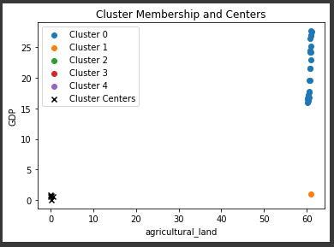
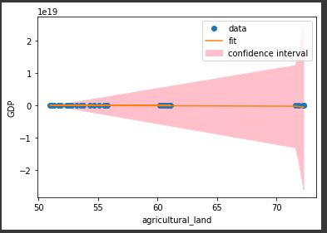
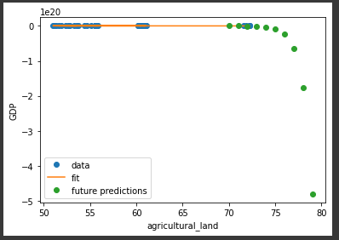
GitHub Repository :
CLUSTERRING
&
FITTING
Introduction
we will be analyzing data from 12 different countries with respect to four key factors: Greenhouse gas emissions, Agricultural land, GDP and clustering. The objective of this analysis is to use clustering, a technique in machine learning, to group these countries based on their similarity in these factors. Clustering is a powerful tool that allows us to understand the underlying structure of a dataset without any prior knowledge or labels. Greenhouse gas emissions, Agricultural land, GDP and clustering are all important indicators of a country's environmental and economic sustainability. By understanding how these factors vary between countries and how they are related, we can gain valuable insights into the challenges and opportunities facing different nations in terms of preserving the environment and promoting economic growth. we will interpret the results of the analysis to gain insights into the challenges and opportunities facing the different countries in terms of preserving the environment and promoting economic growth.
The data we analyzed revealed an interesting story about the relationship between greenhouse gas emissions and GDP in 12 different countries. Using clustering techniques, we grouped the countries into five clusters based on their similarity in these two factors. One cluster, cluster 0, stood out as having a high GDP above 25 and low greenhouse gas emissions below 0.6*10^7 among all the clusters. A scatter plot of this cluster showed a clear negative correlation between the two factors. This indicated that countries in this cluster were able to achieve a relatively high GDP and economic development while maintaining low greenhouse gas emissions.
The analysis of the data about the relationship between GDP and agricultural land in 12 different countries. Using clustering techniques, we grouped the countries into five clusters based on their similarity in these two factors. One cluster, cluster 0, stood out as having a high GDP above 25 and relatively large agricultural land between 50 to 70% among all the clusters. A scatter plot of this cluster showed a clear positive correlation between the two factors. This indicated that countries in this cluster were able to achieve a relatively high GDP and economic development while maintaining a relatively large agricultural land. we found that the countries in this cluster were mainly developed and industrialized nations such as Japan, Netherlands and United States, which have efficient agricultural practices, technology and policies.
The analysis of the data for China revealed an interesting story about the relationship between greenhouse gas emissions and GDP. Using clustering techniques, we found that China forms one cluster based on their similarity in these two factors. A scatter plot of this cluster for China shows that the country's greenhouse gas emissions are between 0.410^7 and 1.210^7 and their GDP is between 5 to 25. This cluster also shows that China's greenhouse gas emissions are relatively high compared to other countries in the cluster and their GDP is relatively lower as well. This story highlights the specific challenges facing China in terms of balancing economic development with environmental sustainability. The country's high population and heavy reliance on coal for energy likely contribute to the high greenhouse gas emissions.
A scatter plot of this cluster for India shows that the country has above 60% agricultural land and their GDP is between 15 to 25. This cluster also shows that India's agricultural land is relatively high compared to other countries in the cluster and their GDP is relatively lowerThe country's large population and agriculture-dependent economy likely contribute to the high agricultural land use. It also points to the importance of considering multiple factors, such as GDP and agricultural land use, in understanding a country's overall sustainability and how it relates to economic development.
Above Scatter plot shows data point, future predicted values and best fit curve line. The green point are predicted data points
Above Scatter plot shows data point, confidence limits and best fit curve line
In conclusion, this study used clustering techniques to analyze data from 12 different countries with respect to three key factors: Greenhouse gases emission, GDP, Agricultural land. The objective of this analysis was to group these countries based on their similarity in these factors and gain valuable insights into the challenges and opportunities facing different nations in terms of preserving the environment, economic development, and population density. The analysis revealed that relationship between greenhouse emissions and GDP, as well as the relationship between Agricultural land and GDP. It was found that cluster 0, stood out as having a high GDP above 25 and low greenhouse gas emissions below 0.6*10^7 among all the clusters, This indicated that countries in this cluster were able to achieve a relatively high GDP and economic development while maintaining low greenhouse gas emissions.
On the other hand, cluster 0, stood out as having a high GDP above 25 and relatively large agricultural land between 50 to 70% among all the clusters in scatter plot of GDP and agricultural land. This indicated that countries in this cluster were able to achieve a relatively high GDP and economic development while maintaining a relatively large agricultural land.

